Slide 1

Practical Infrastructure Automation for Red Teams
Cedric Owens
CarolinaCon 2021

Slide 2




BIO
Red Team @
Husband and Father
NC is home, but live in Austin, TX
Enjoy macOS post exploitation and infra automation
Love 80s and 90s nostalgia
NC has the best bbq

Slide 3

AGENDA
A Brief Look At Red Teams Today
Opportunities for Automation
Examples of Automation
Lessons Learned

Slide 4
Overview of red teams today

Slide 5

Red team – a loaded plate
Program planning
Operations planning
Research
Tool development/customization
Infrastructure management
Operations execution (running the ops)
Debriefing and communicating with execs
Blue team collaboration
80%
15%

Slide 6

Red team – a loaded plate
Internal corporate red teams are often small in size
Always more work to do than available bandwidth
Maximizing time is key
Automation to the rescue!
80%
15%

Slide 7
Opportunities for automation

Slide 8

Infrastructure needs
Infra is one of the core needs of red teams
Secure
Realistic
Scalable
Flexible
Infra needed for various reasons:
Phishing
Command and Control
Exfiltration
File Hosting
Redirectors
80%
15%

Slide 9
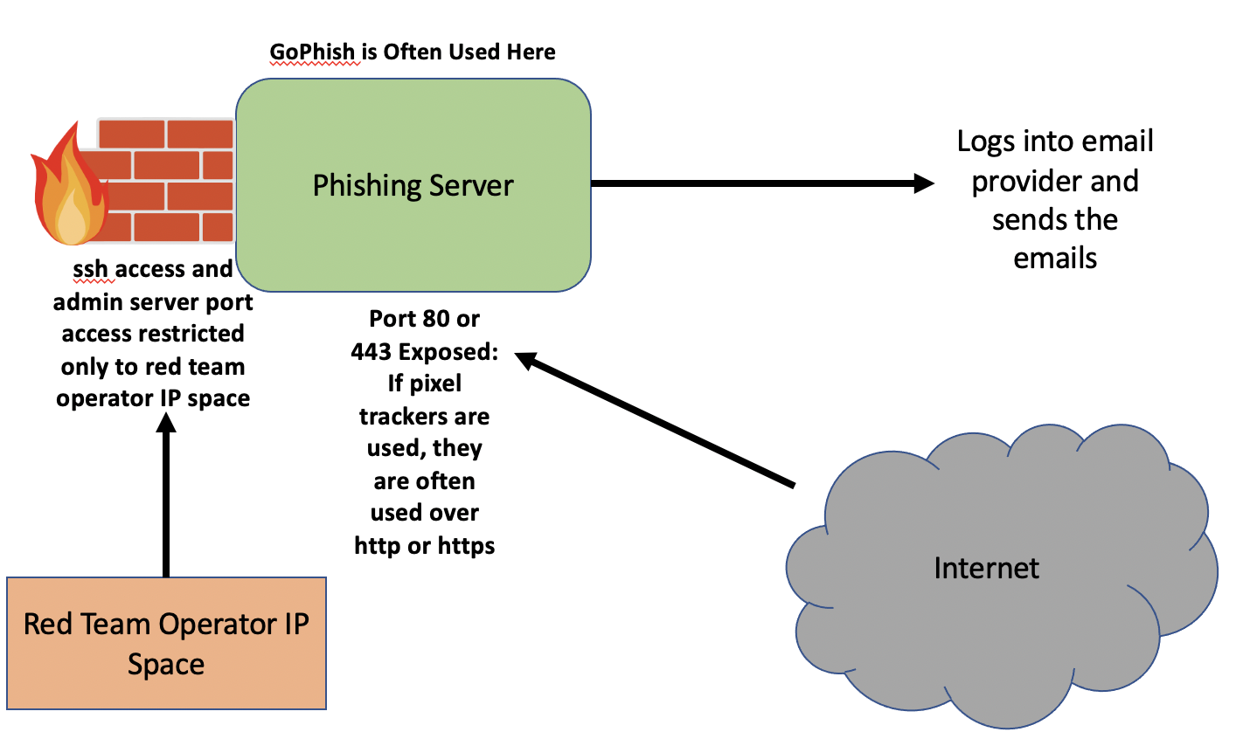
Infra needs – phishing
80%
15%

Slide 10
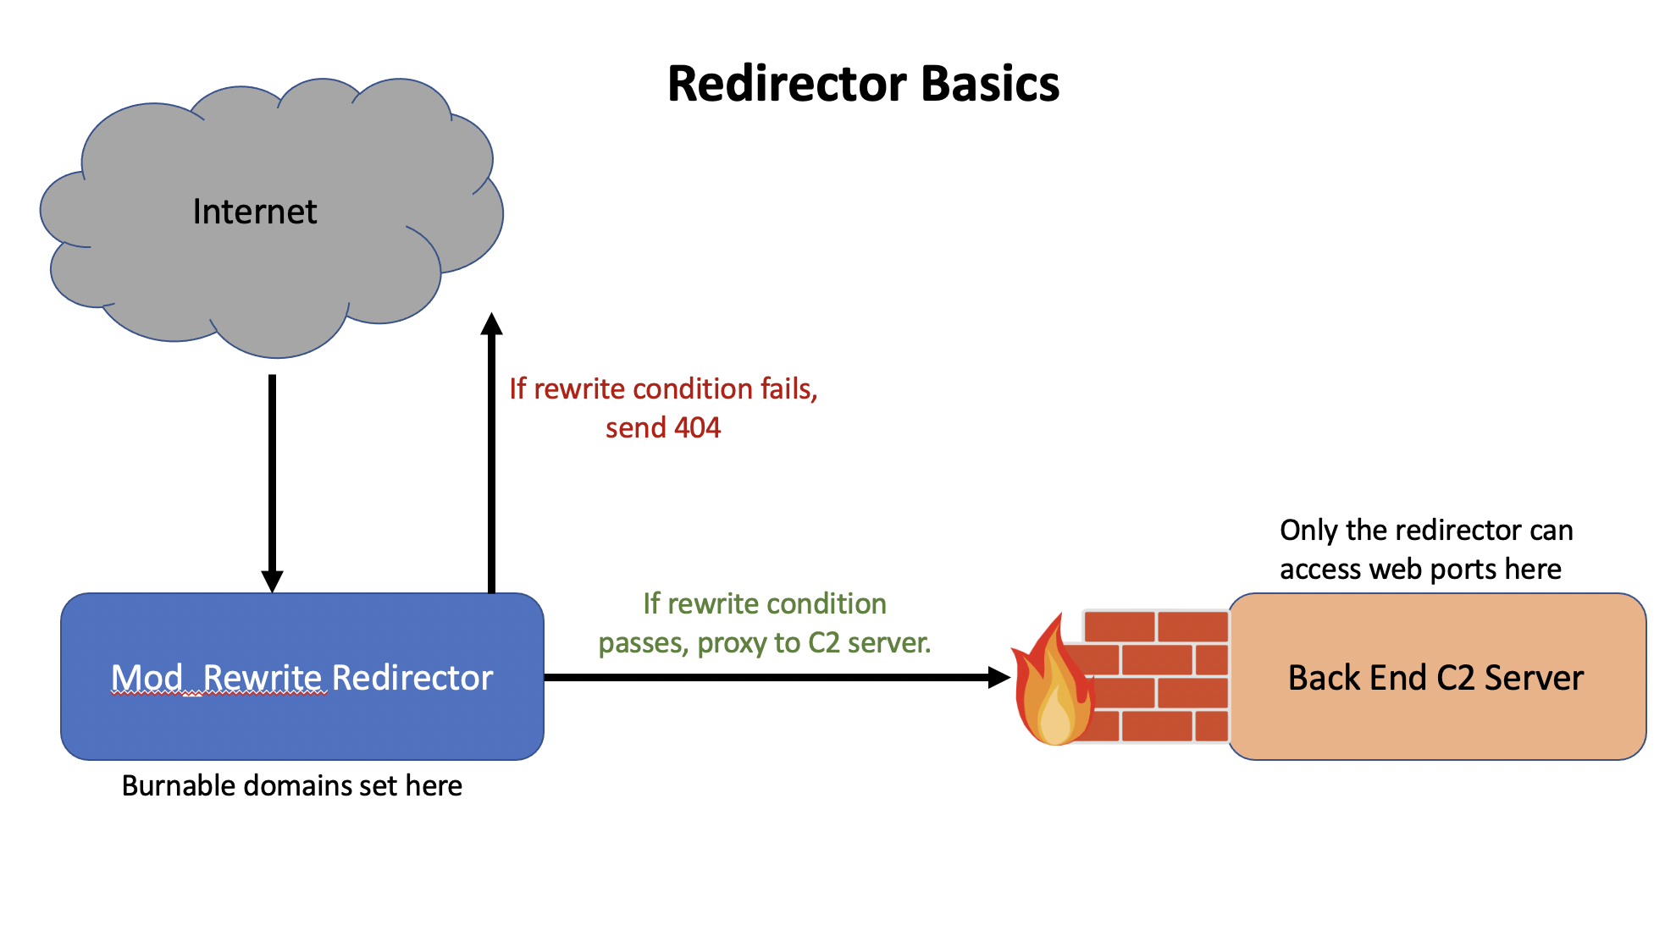
Infra needs – redirectors
80%
15%

Slide 11
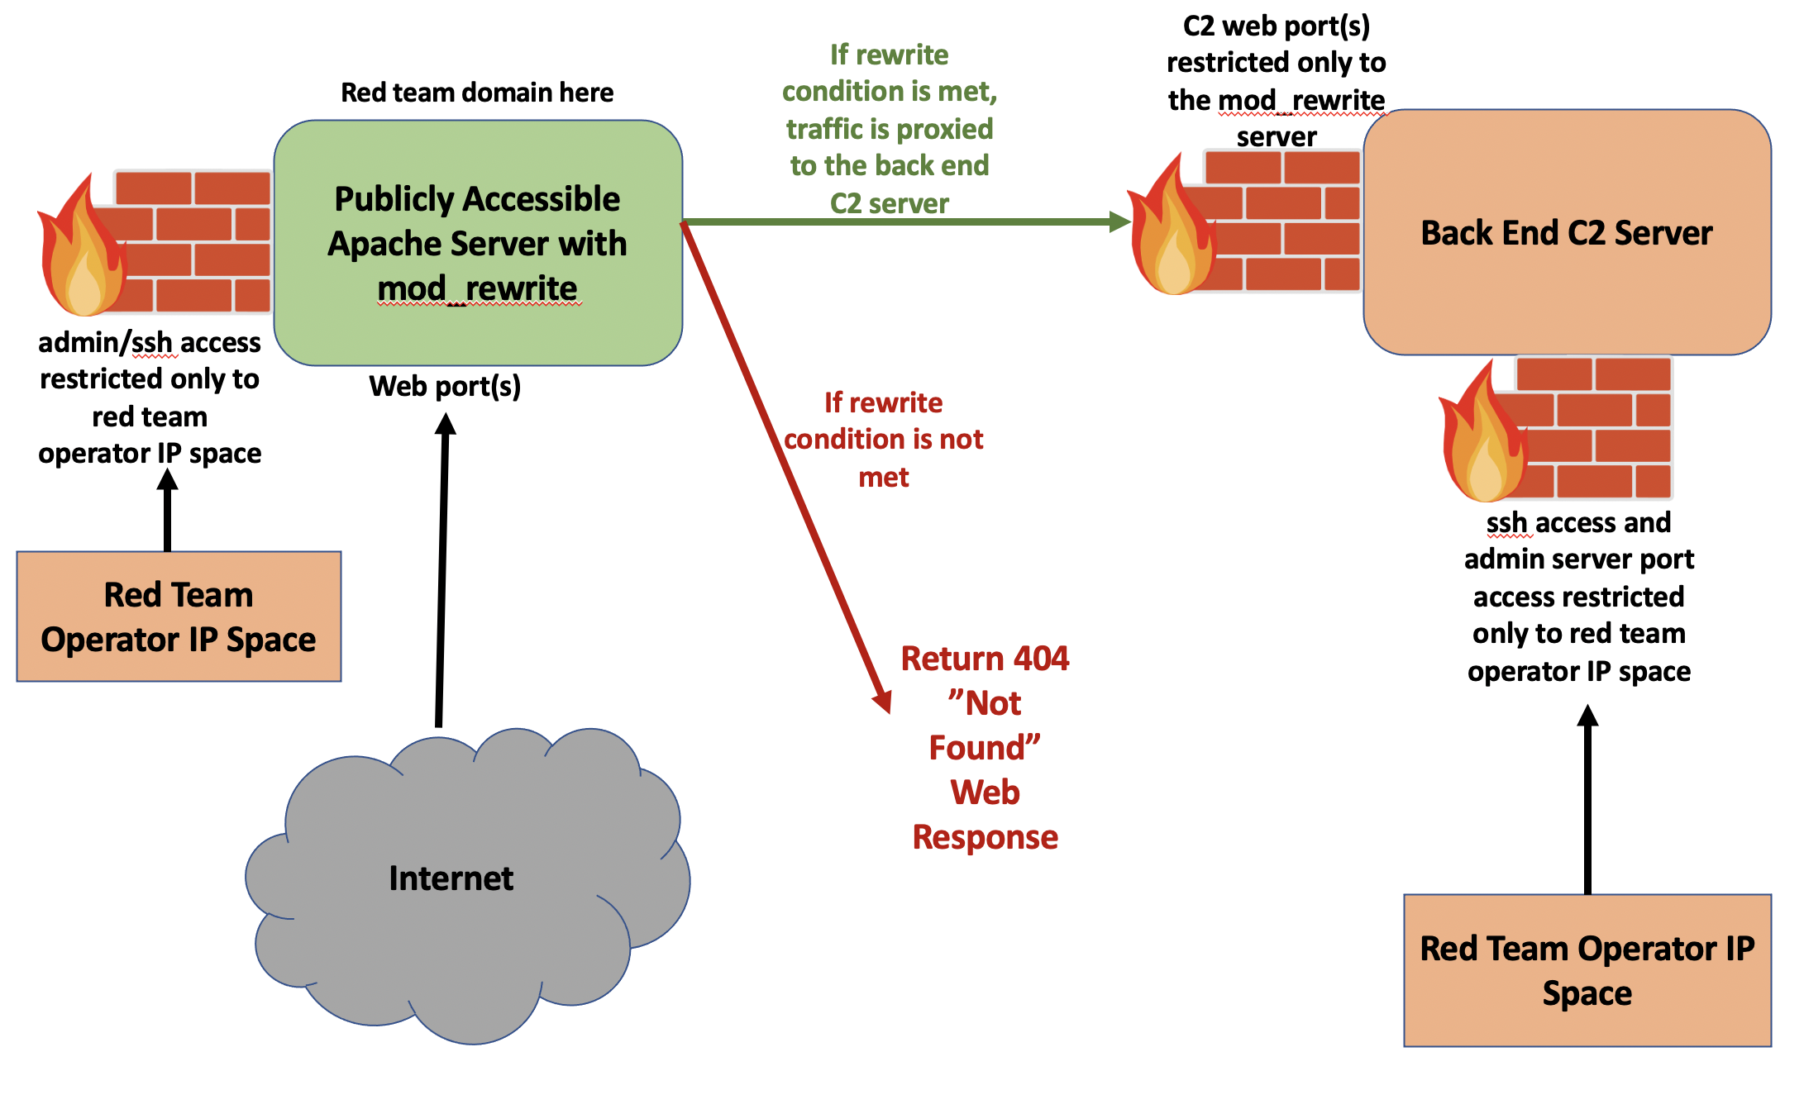
Infra needs – C2
80%
15%

Slide 12
Automation examples

Slide 13

Automation examples - overview
Different Approaches and Tools
An approach that I like:
Shell script: captures config info and edits Terraform scripts.
Terraform scripts: spin up infra
Can use this approach across various cloud providers:
Linode, DigitalOcean, AWS, GCP, etc.

Slide 14


Automation example – phish server
GoPhish phishing server
DigitalOcean provider
Setup:
In DO, set up:
API key
ssh key
Shell script will get config info
Terraform will spin it up

Slide 15
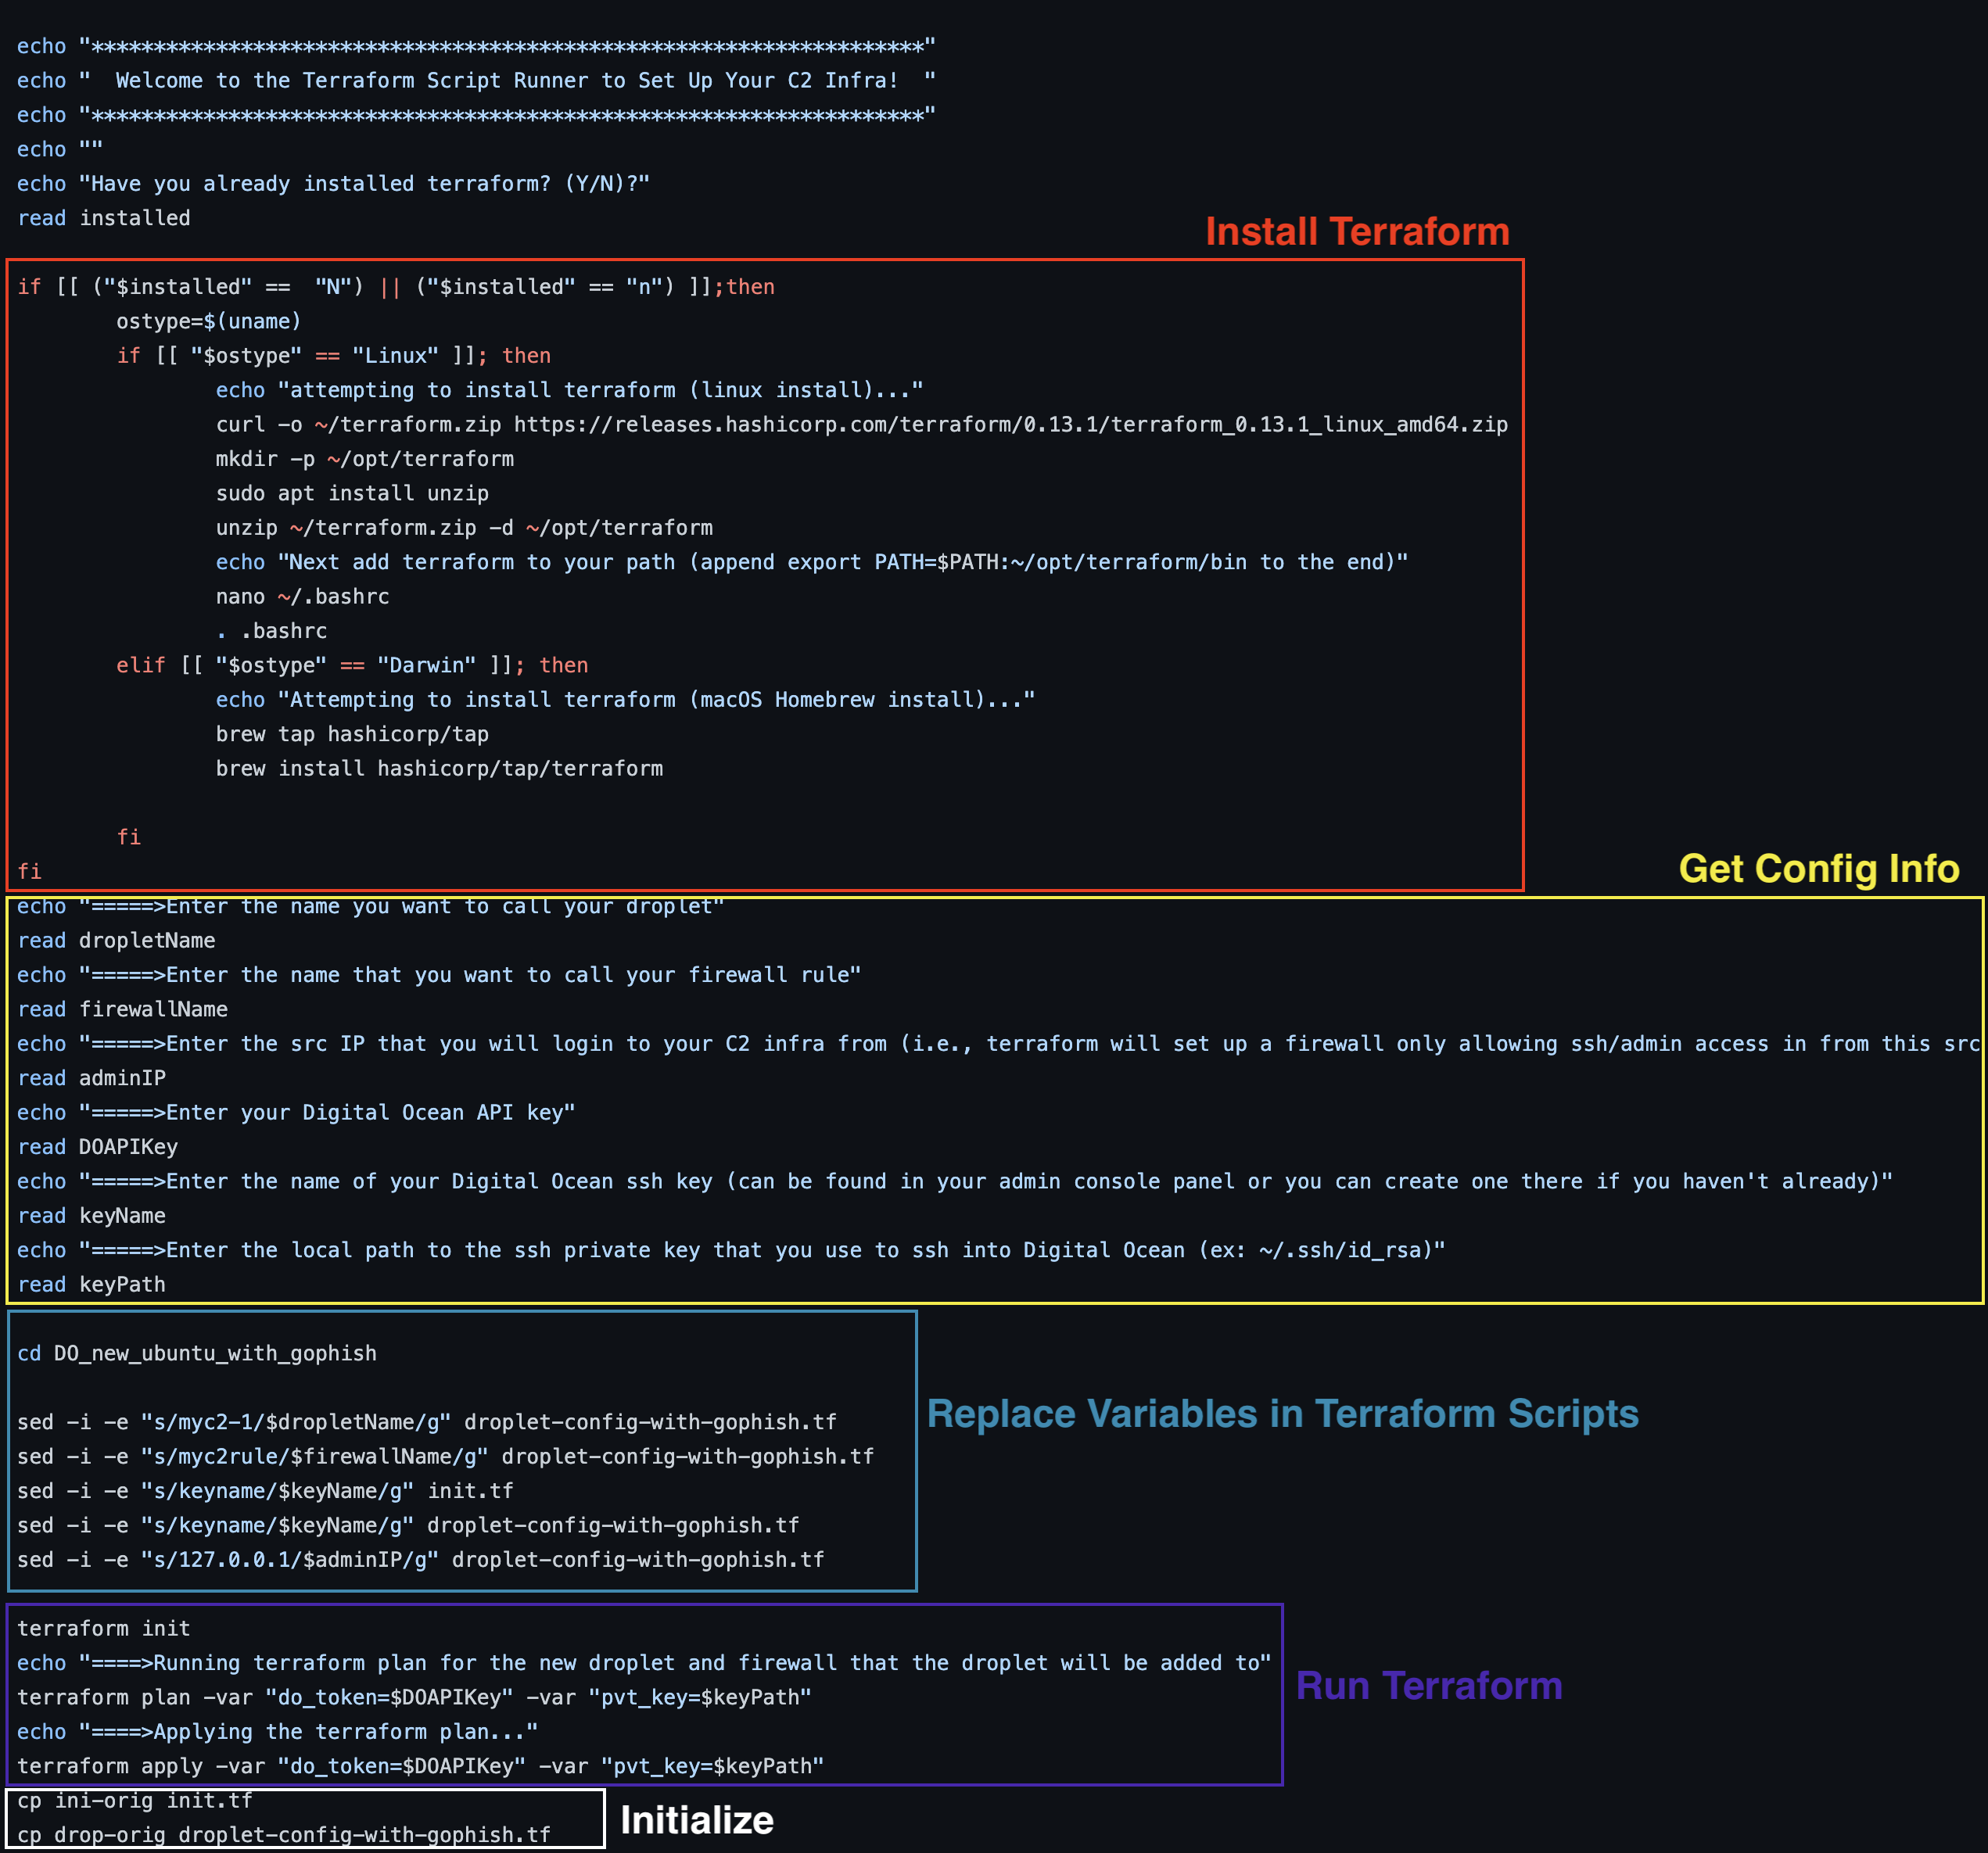
Shell Script

Slide 16
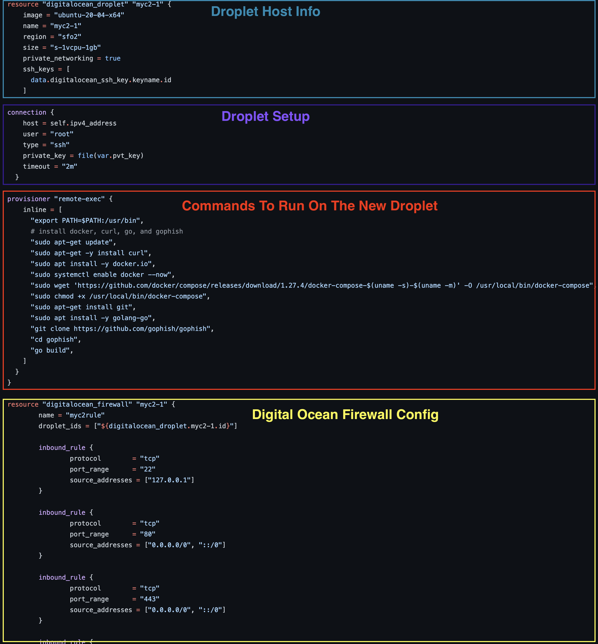
Terraform Script

Slide 17
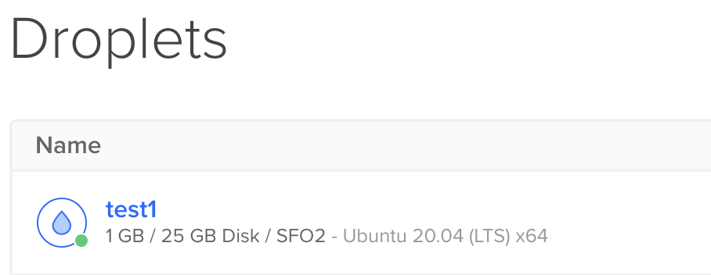
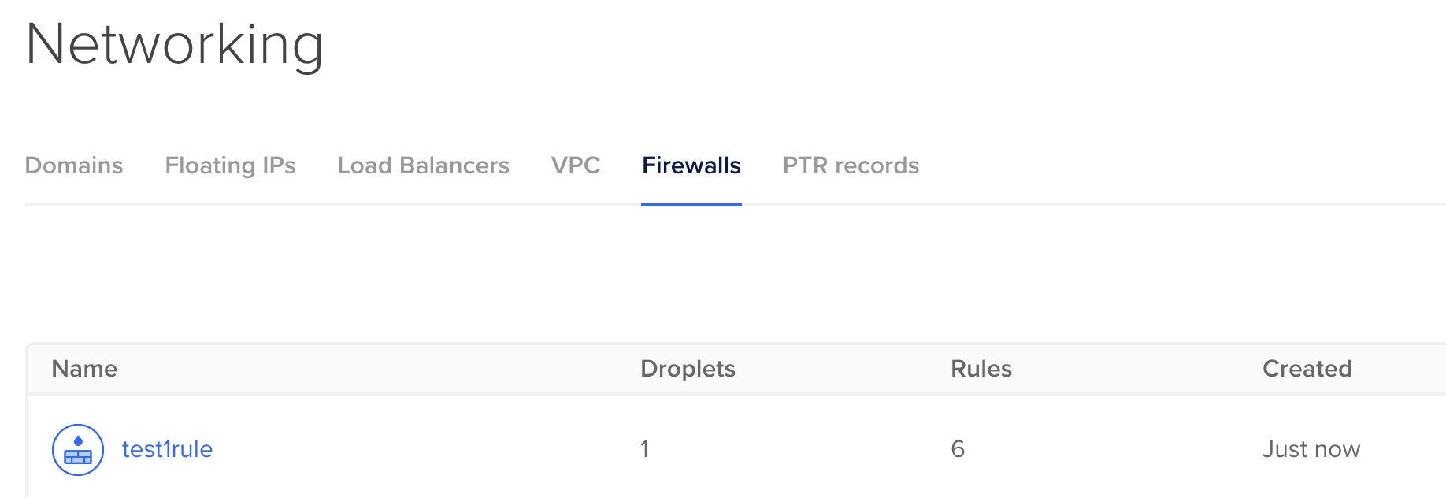
Automation example – phish server
Phishing server is protected behind firewall rules
Can ssh in and run the gophish server
Much quicker
More flexible during live operations

Slide 18
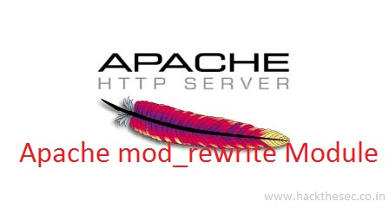

Automation example – redirectors
Put in front of C2 servers
Red Team domains for the redirectors
Only allow C2 traffic
Redirect all other traffic
Apache Mod_Rewrite
In Linode, set up:
Personal access token
On host: generate ssh key pair

Slide 19
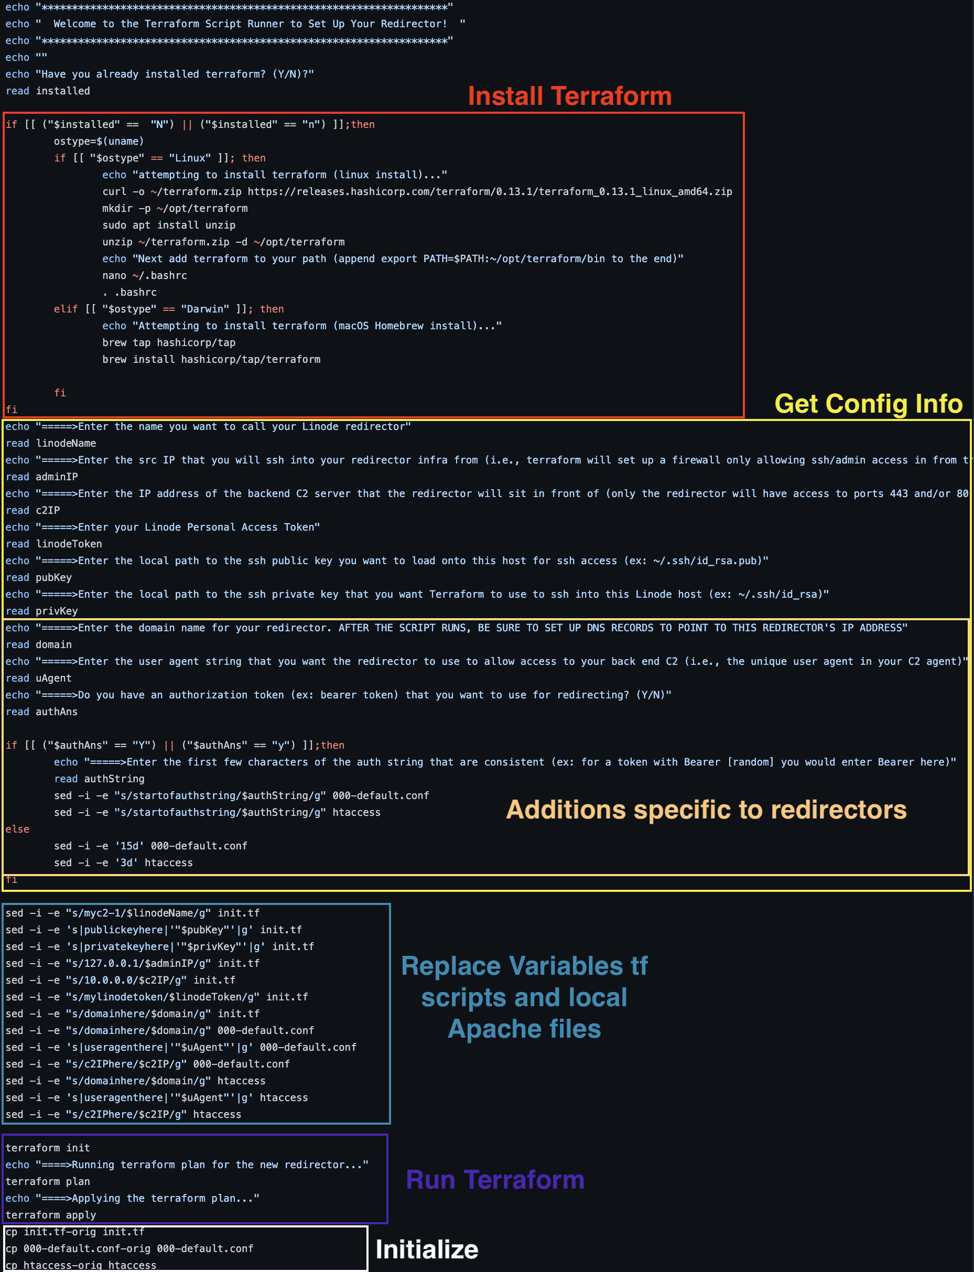
Shell Script
(for http redirector)

Slide 20
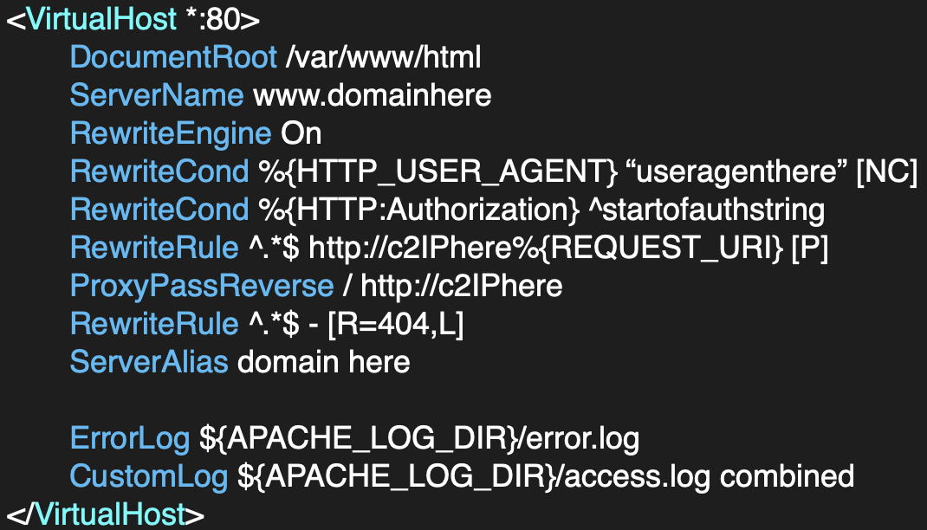
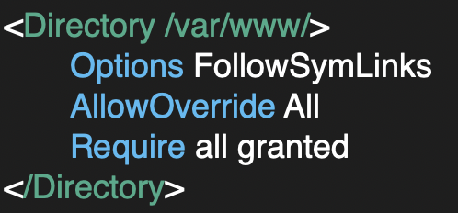
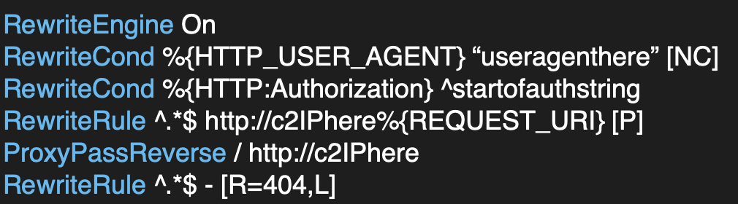
Apache Files (template copies stored locally and later copied to the new linode redirector)
000-default.conf
apache2.conf: ensure your local copy includes this
.htaccess

Slide 21
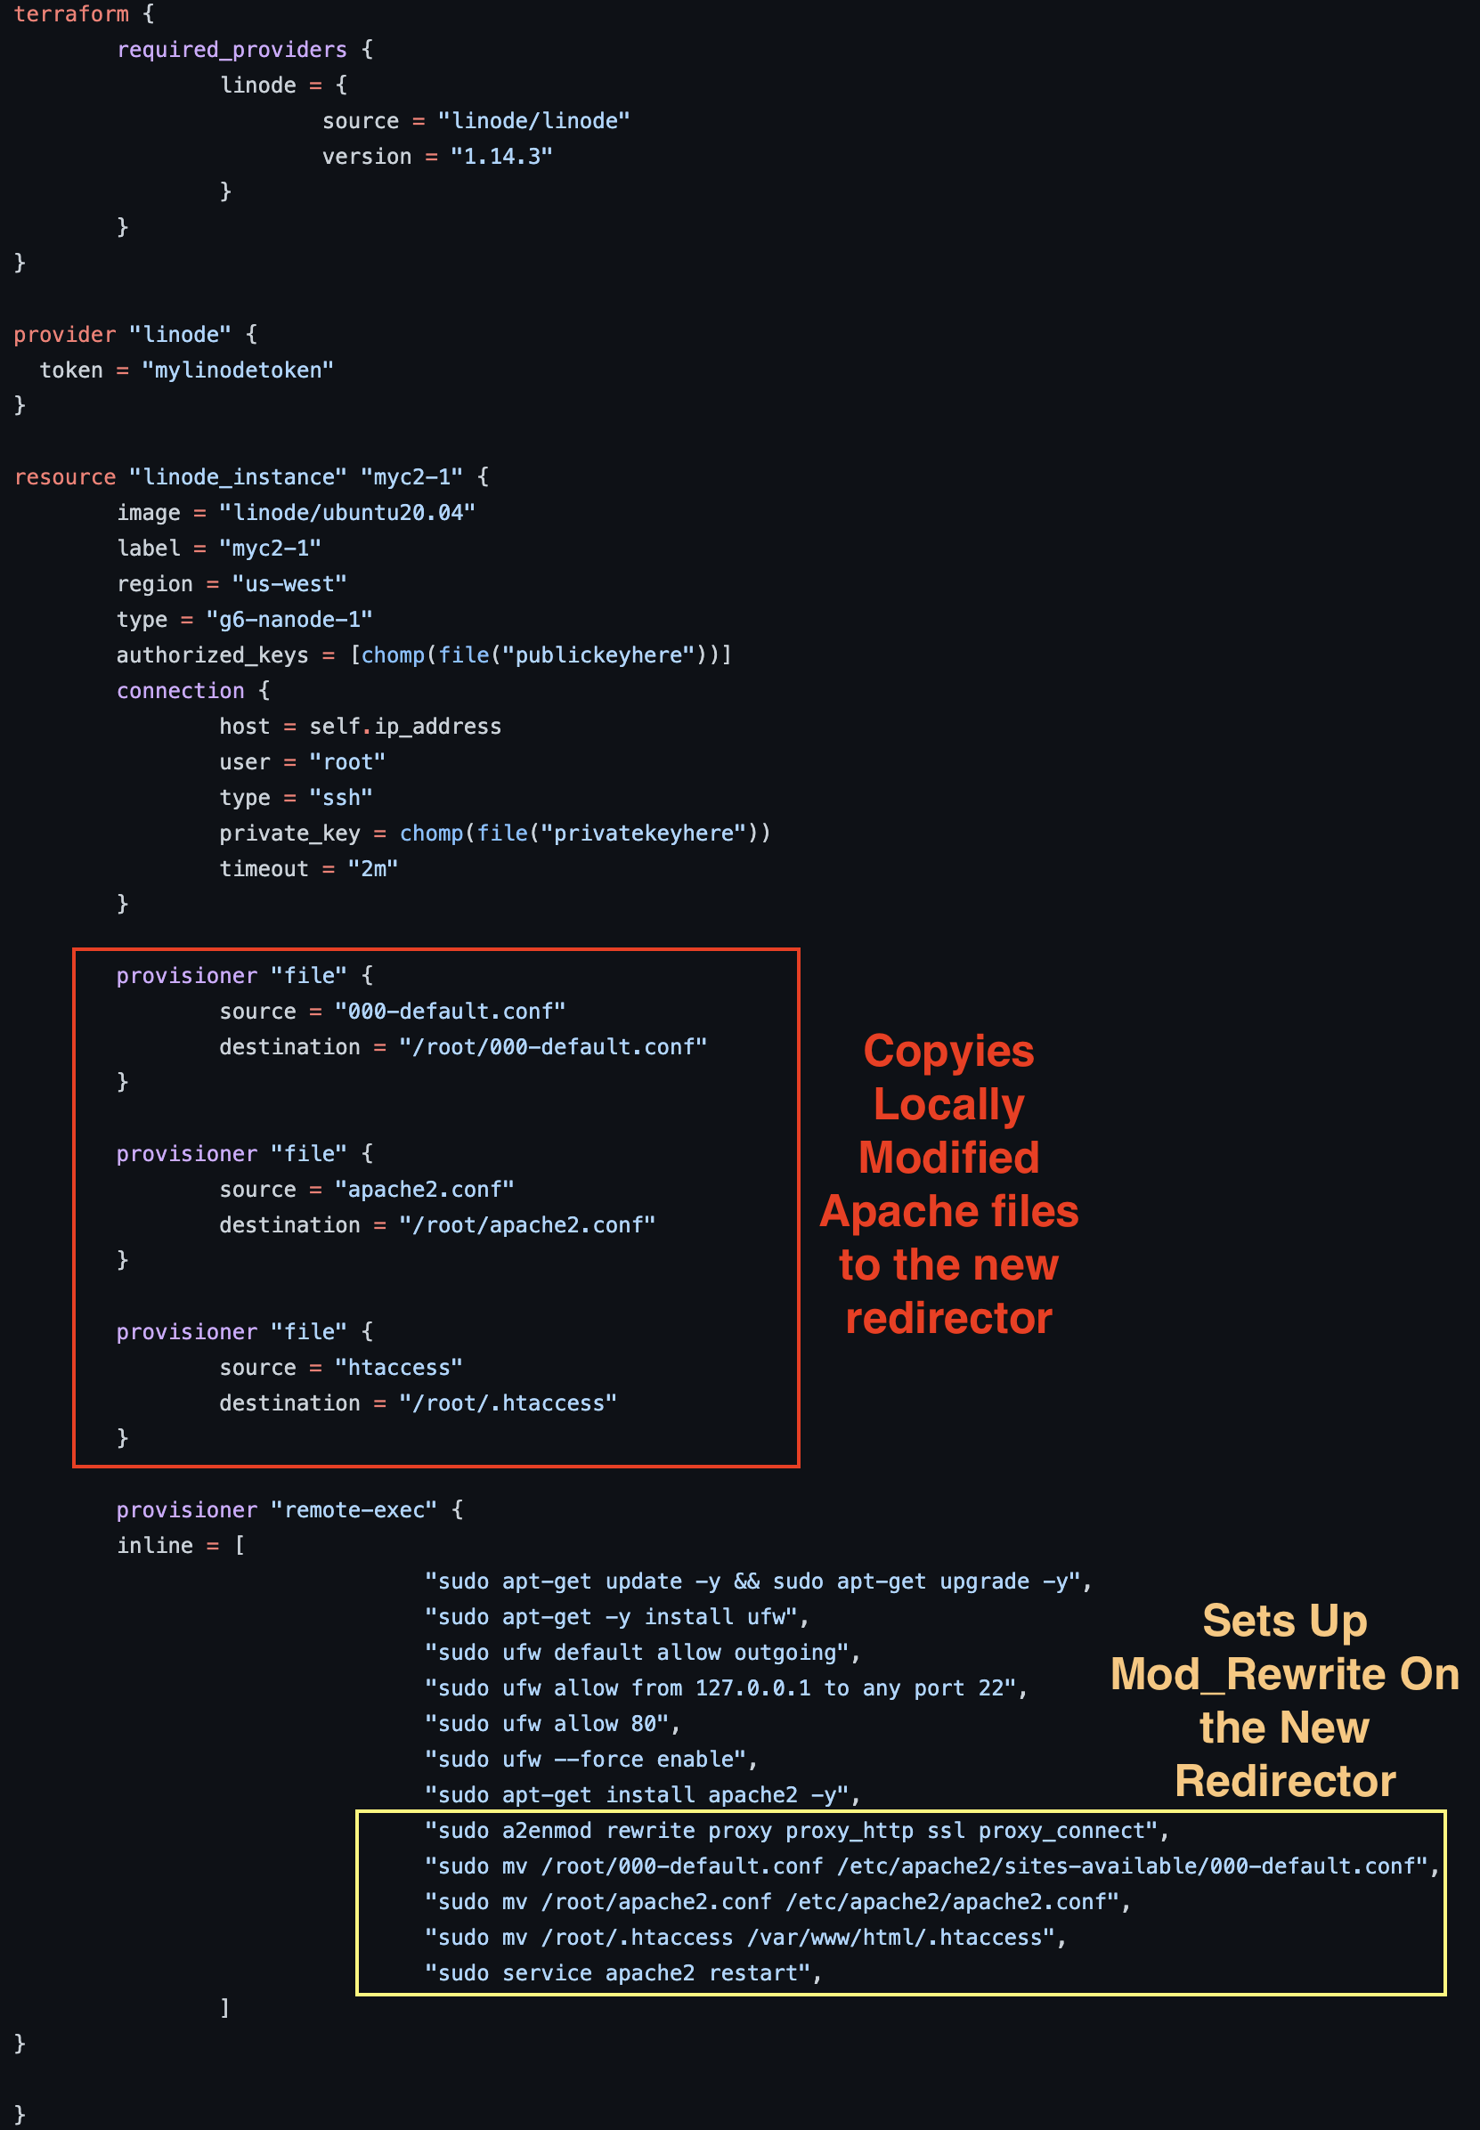
Terraform Script (for http redirector)

Slide 22
When run, redirector is up!

Slide 23
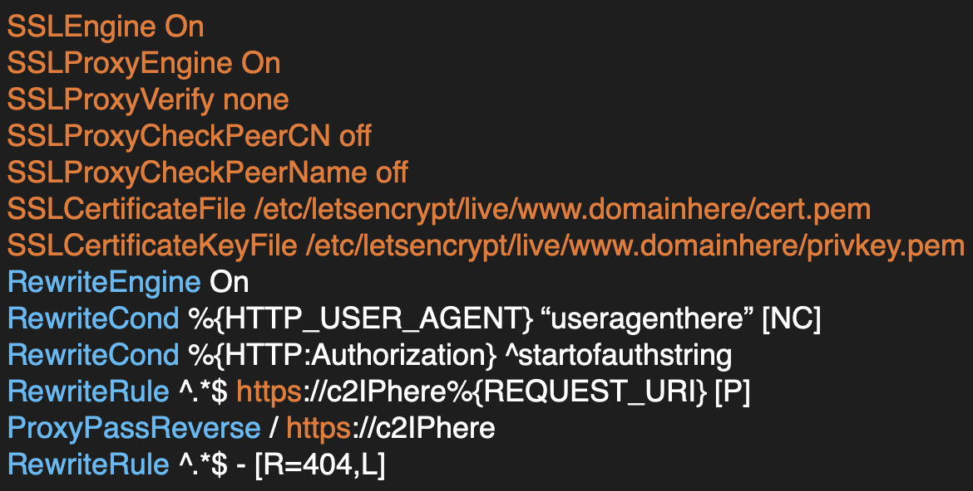
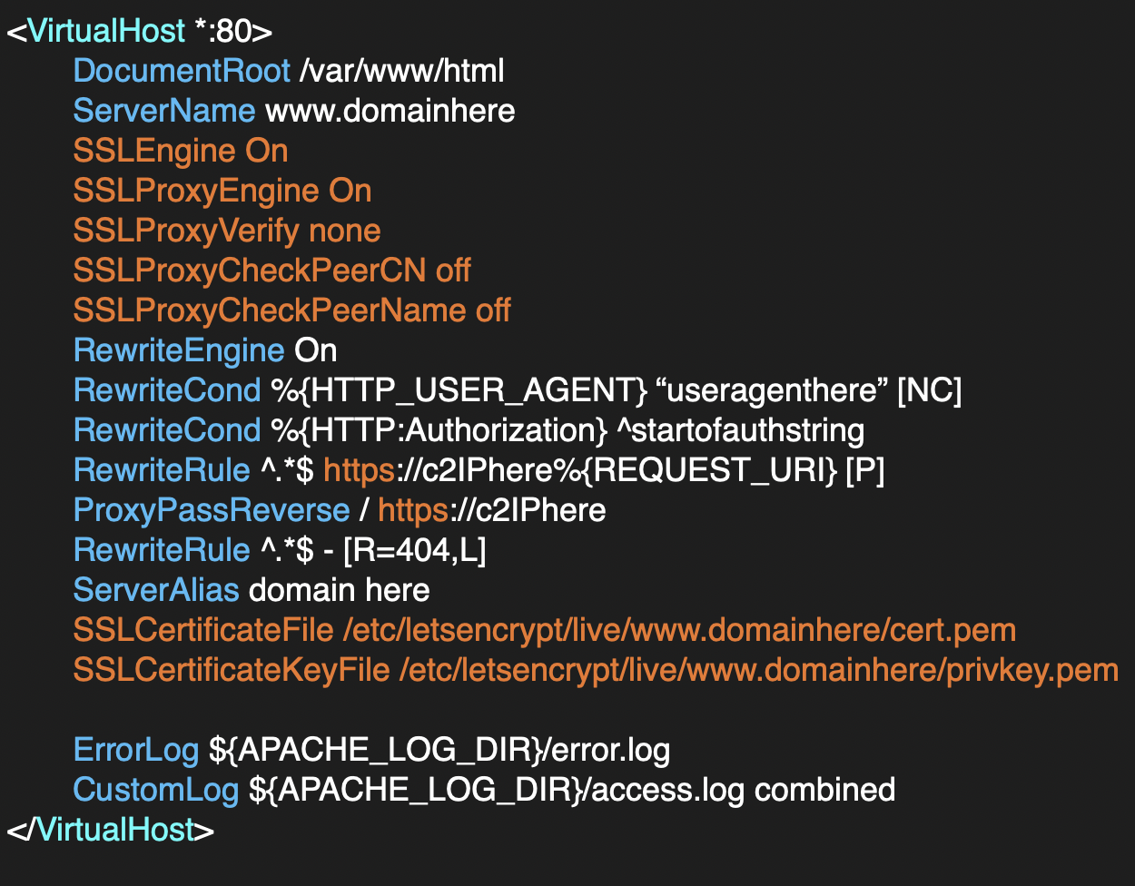
SSL Redirector Apache Files (template copies stored locally and later copied to the new linode redirector)
.htaccess
000-default.conf
apache2.conf: ensure your local copy includes this

Slide 24
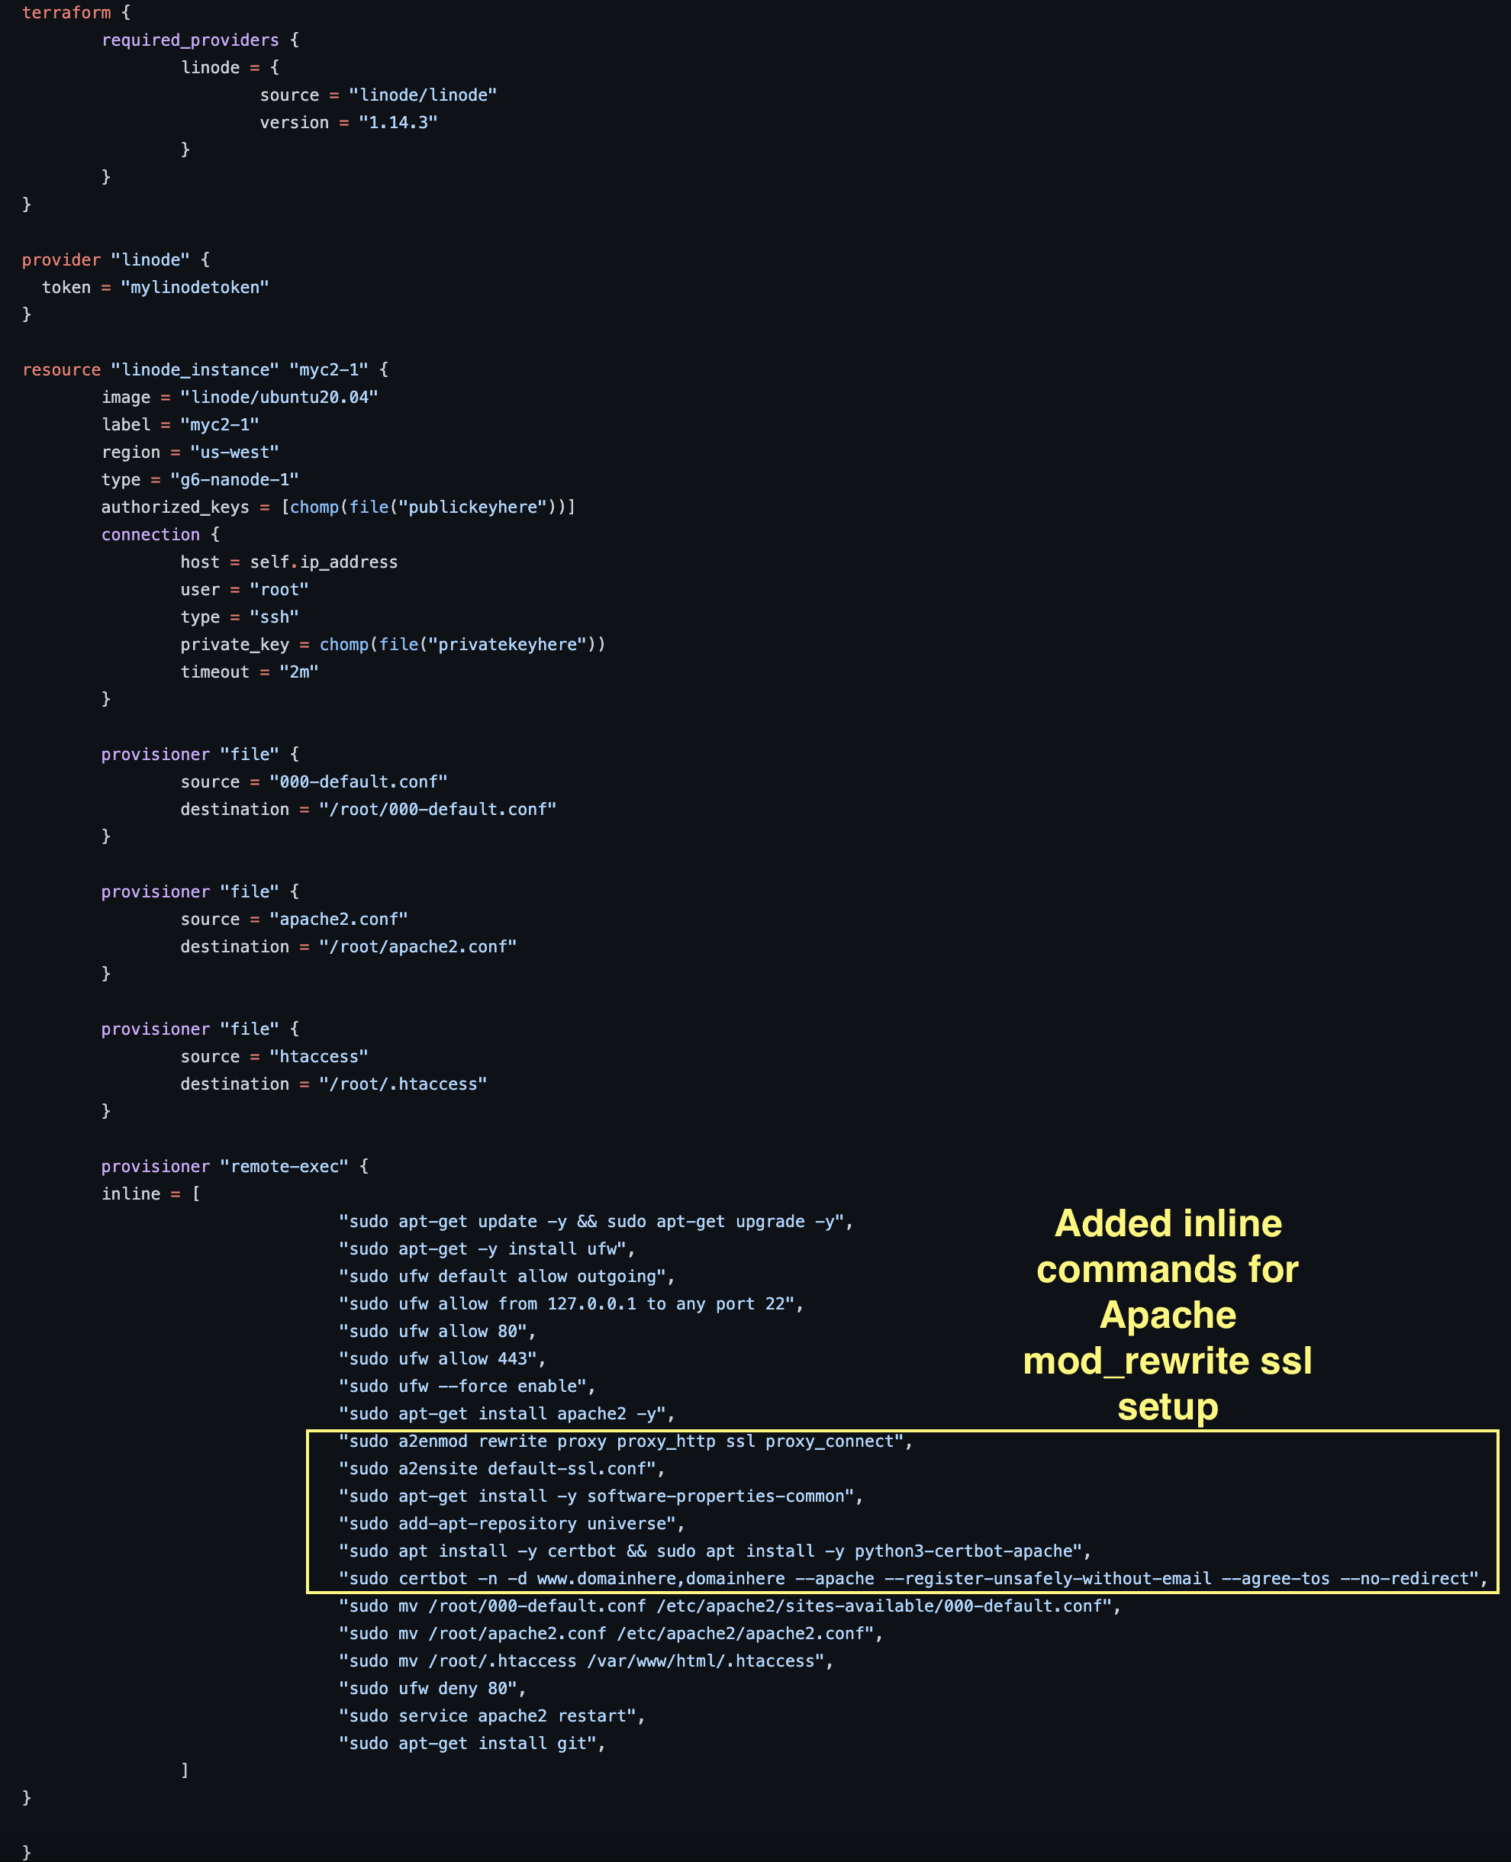
Terraform Script (for SSL redirector)

Slide 25

Benefits of this approach
Takes the pain out of mod_rewrite config
Takes care of SSL cert for new redirector
Redirectors are C2 agnostic
Filter by request header values
Mod_rewrite provides more granularity than socat
socat is good for when you want to simply redirect all traffic
More resilient when domain gets burned
Spin up a new redirector with a new domain
Back end C2 infra not exposed

Slide 26

Lessons learned
Can’t automate red teaming itself, but automation can be helpful!
Lots of different approaches/tools for automation
Pick what you are most comfortable with
Should be scalable, secure, and flexible
I recommend red teams automate as much infra management as possible
Maintain good documentation on your infrastructure setup
If possible, have both a segmented internal infra environment as well as a fully external infra environment
Will help with different exercise scenarios

Slide 27
references
My blog on Red Team Infra Automation: https://medium.com/red-teaming-with-a-blue-team-mentality/b4c613308beb
My Linode Terraform Scripts: https://github.com/cedowens/Linode_Terraform_Scripts
My Digital Ocean Terraform Scripts: https://github.com/cedowens/Terraform_DigitalOcean_Scripts
My mod_rewrite Automation Scripts: https://github.com/cedowens/Mod_Rewrite_Automation
Tim MalcomVetter’s blog on Safe Red Team Infra: https://malcomvetter.medium.com/safe-red-team-infrastructure-c5d6a0f13fac
Jeff Dimmock’s wiki on Red Team Infra: https://github.com/bluscreenofjeff/Red-Team-Infrastructure-Wiki

Slide 28

Thank you!

